Slide 1
Reorganizing the Team for Efficiency
August 18, 2020 Jeff Cown, Director
Notes:
Several organizational changes have recently occurred within Department of Natural Resources:
The Historic Preservation Division has transitioned to Department of Community Affairs on July 1st, while DNR retained the Archeology Unit.
Also, the Wildlife Resources and Law Enforcement Divisions realigned their regions from different alignments to six Regions creating the same regional boundaries to bring about consistency and provide a more cohesive approach during natural disasters, emergency operations and inter-agency initiatives.

Slide 2
Reorganization Goals
Goals of this restructure are to:
Establish the same region boundaries to bring further consistency within the Department’s Law Enforcement, Wildlife Resources and Parks Divisions
Streamline services for higher efficiency
Reduced duplication of services
Improve span of control for headquarters and region level supervisors
Notes:
I have evaluated the region boundary alignments as well as the HPD changes and have determined we must restructure at the region and division level. The goals of this restructure are to:
Establish the same region boundaries to bring further consistency within the Department’s Law Enforcement, Wildlife Resources and Parks Divisions
Streamline services for higher efficiency
Reduced duplication of services
Improve span of control for headquarters and region level supervisors

Slide 3
HQ Changes
New Organization Charts Coming Soon, effective October 1st
Administrative changes to blend the former HPD Staff and PRHS Staff
Eliminate duplication of effort and ensure we function at the highest level of efficiency, while also addressing span of control for supervisors
Supervisors will hold meetings with newly assigned Staff

Slide 4
Region Changes
New Organization Charts Coming Soon, tentatively effective October 1st
Advertise & Fill Operations Chief’s position
Phase 1 FY21 – Region Management
  Management changes include Region Management supervision of Park and Historic Site Managers and their respective park or historic site
  Direct supervision of the AOM’s during FY21 will remain with the current supervisor
Phase 1 FY21 – Region Administration
  Regional administrative changes will occur effective July 1, 2021, the start of FY22.
  Physical office work locations will be based on current office space available until remodeling, new construction or other opportunities become available
  During FY21, Administrative staff will work within the current region boundaries to support the sites that they currently serve, communicating with the appropriate Region Manager

Slide 5
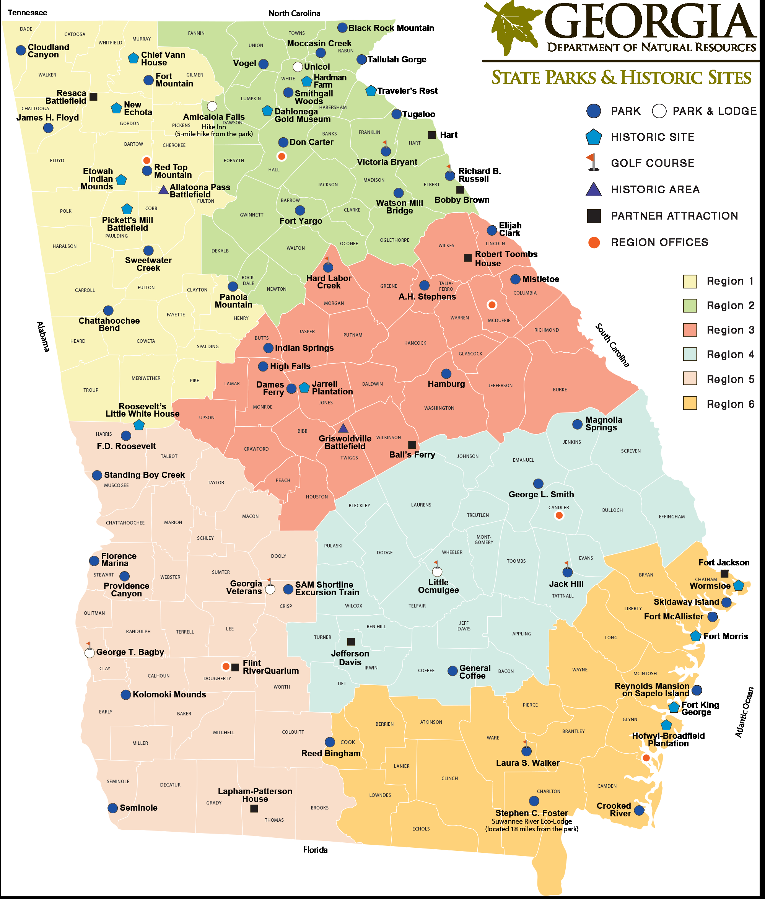
Notes:
I appreciate your support, flexibility, and shared desire to continue moving the Parks, Recreation and Historic Sites Division forward.

